Slide 1
Mom-Village System

Slide 2
Architecture Diagram
Level 0
Level 1
Level 2
With Hierarchal Controller and Asynchronous Communication

Slide 3
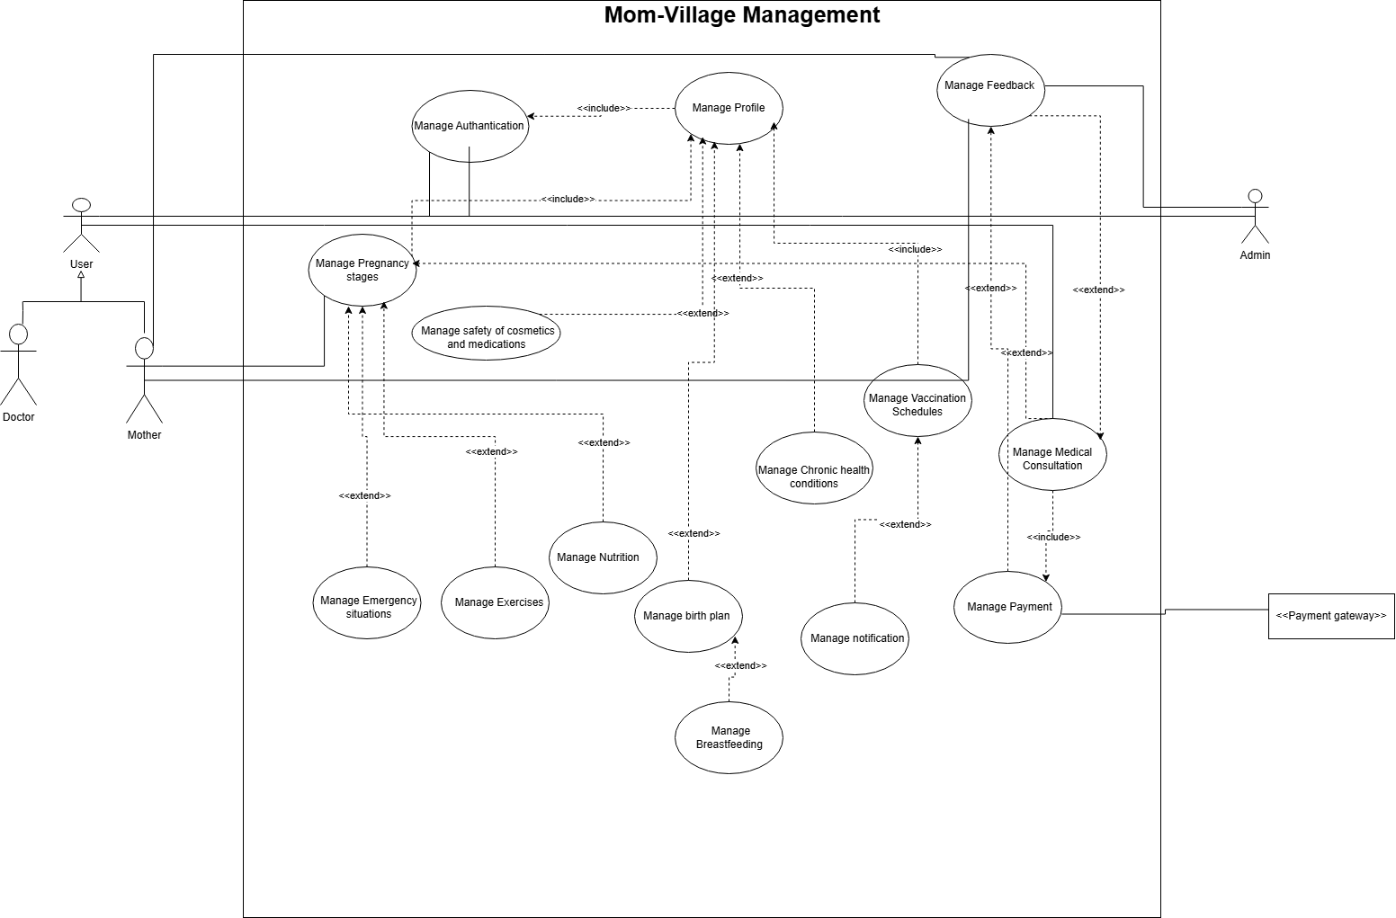
UseCase Diagram
Do not describe a process
This means that every time mother manages the pregnancy stage or manage vaccination schedules →she must manage the profile (make a profile)
But the actual scenario is (Mother must make a profile before manages the pregnancy stage or manage vaccination schedules for the first time)

Slide 4
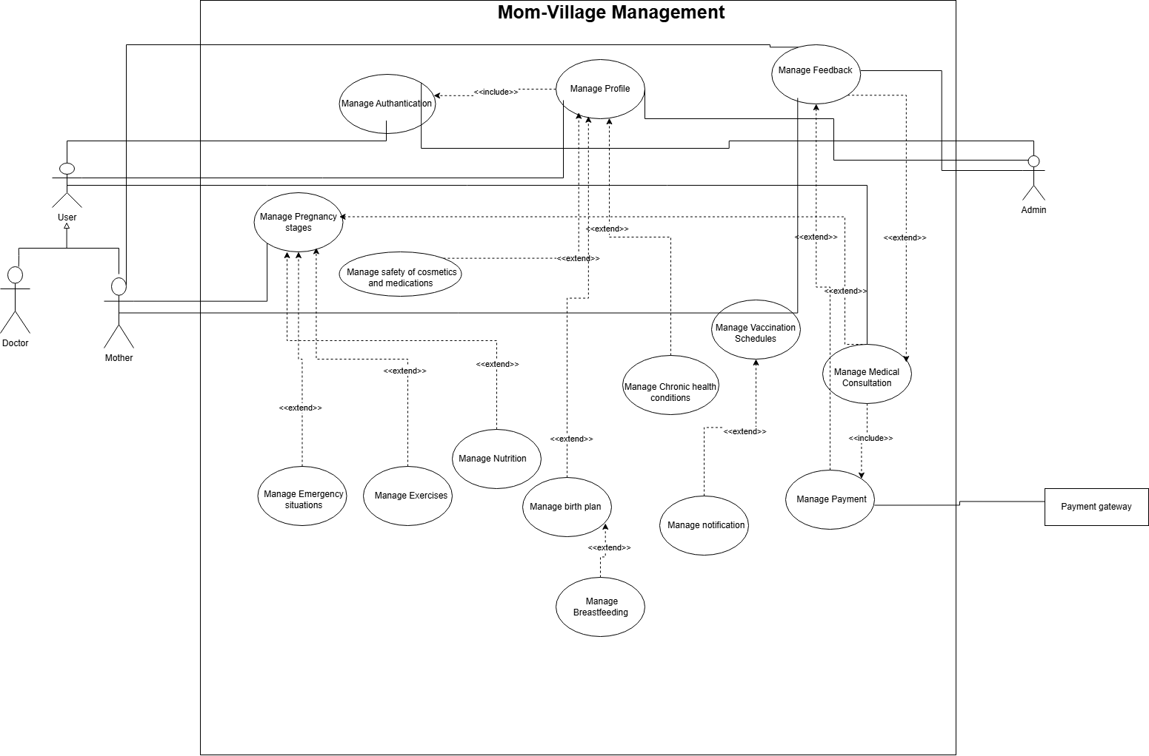

Slide 5
Context diagram describe the system as a block box.
Architecture diagram level 1 introduce subsystems(Components) on the hole system.
Architecture diagram level 2 describe each subsystem on a big scale.
THIS POWER POINT RECOVER A DETAILED EXPLATION OF CENTERALIZE CONTROLER.

Slide 6
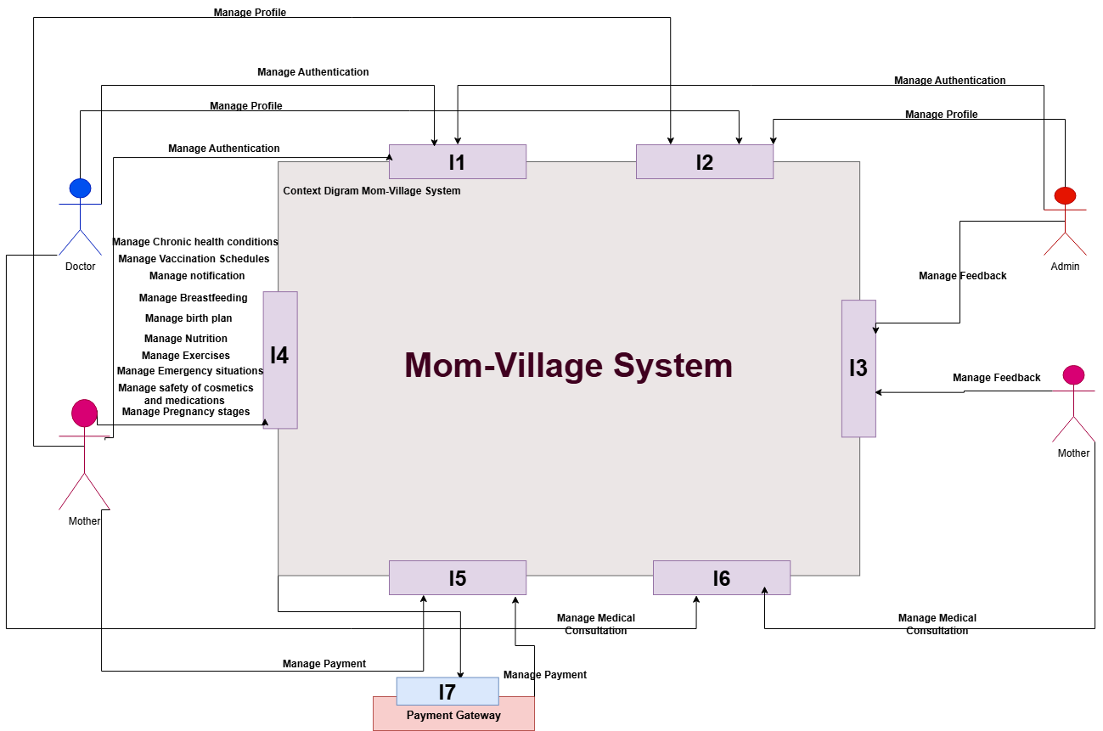
Context Diagram

Slide 7
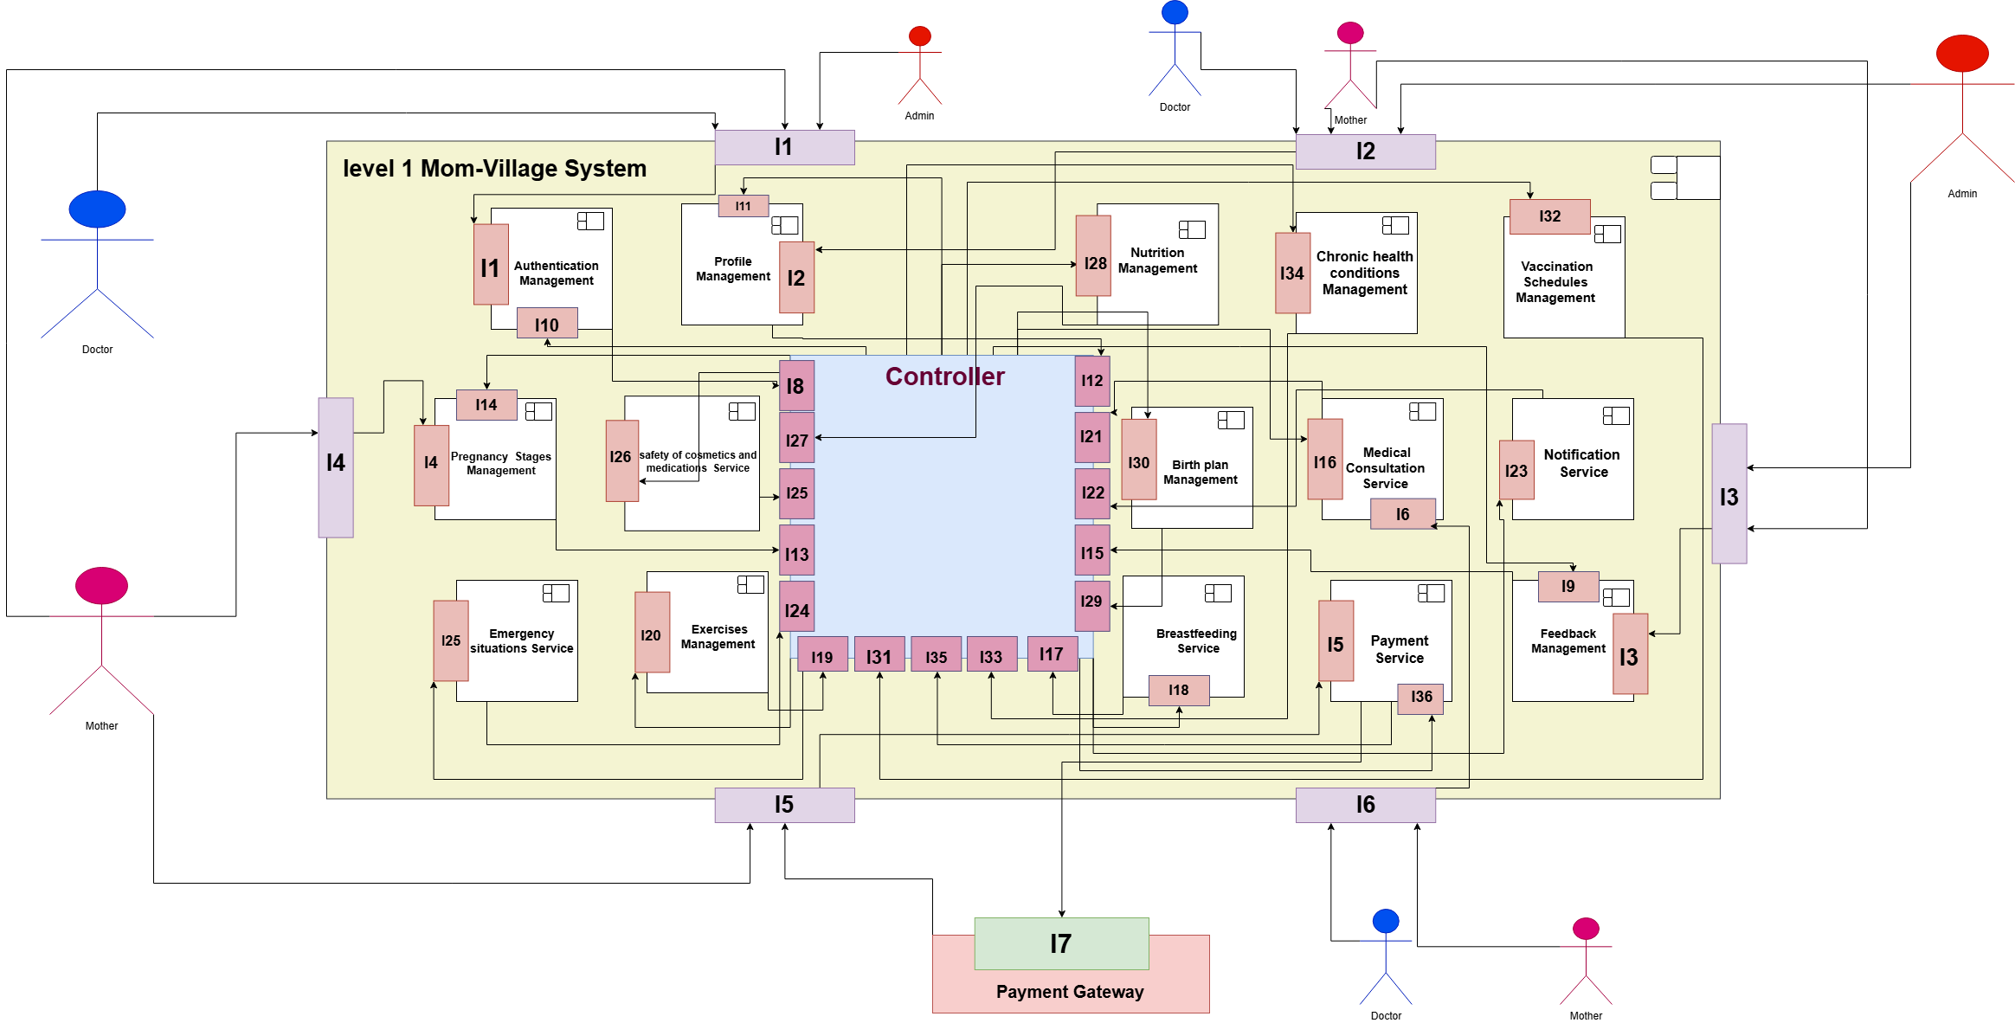
Bad Design High Coupling
Much number of interfaces on the controller
Much number of connection between subsystems (High coupling)

Slide 8
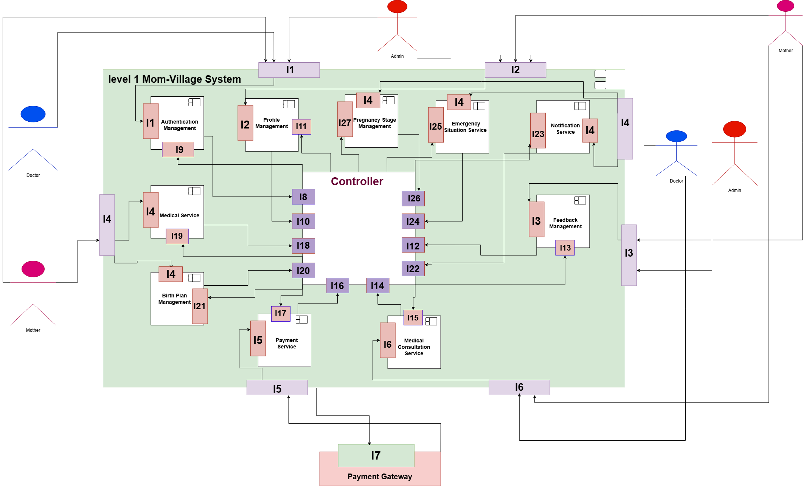
Component diagram Level 1
We reduced number of subsystems by collect the medical subsystems into one called medical service
Number of interfaces has been reduced

Slide 9
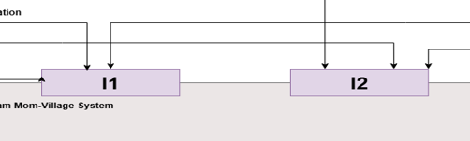
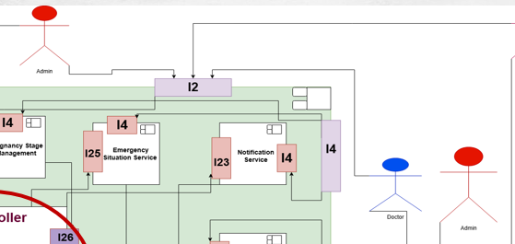
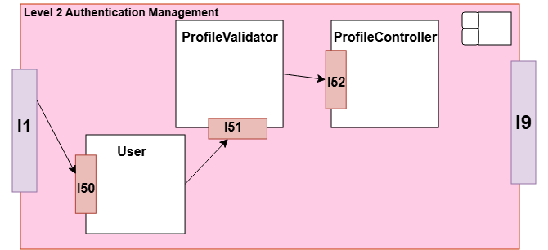
Shared interface
Summery of a good design
Number of interfaces on the context diagram do not exceed 7.
If more than one actor use the same usecase you can make a shared interface between them (Manage Authentication).
All the interfaces on the context diagram must be on the Architecture diagram level 1
Number of Subsystems must reduce as much as possible (6 to 8) is better.
The fewer the number of SUBSYSTEM(Must cover your system requires)→The less the number of interfaces on the controller (Good design).
You can repeat the actors wherever needed to ensure readable design.
You enter a subsystem or a controller from an interface.
On the hierarchal controller you put a controller if there are lots of communication between subsystems
other than this
you do not have to put a controller on your design.

Slide 10
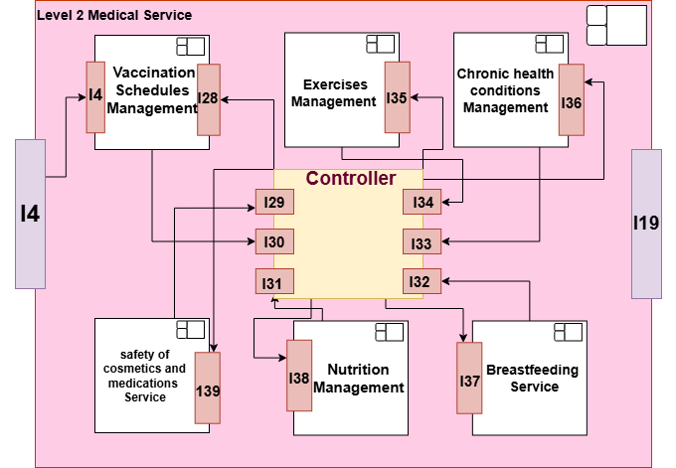
Component Diagram Level 2
(Medical Service)

Slide 11
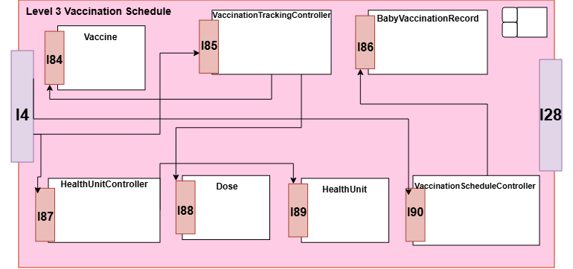
Component Diagram Level 3
(Vaccination Schedule)
Here you start Class Diagram → You do not need Level 3.

Slide 12
About Centralized Controller … with (input/output) modules:
It is better to make an (input/output) module while design → for more security and better usages of controlee style.
While designing (API Gateway is much better and it depends on your System dependency and logic ).
When putting (input/output) modules
The input module will communicate with the controller on a separate interface.
The controller will send to the output module on a separate interface.
Then, the output module will send to the Users of the System.
While the controller interact with each components on a separate interface.
Input module
Output module

Slide 13
Thank You

